Slide 1


LETS BREAKUP
Notes:
Download the Powerpuff Girls font here: https://dafont101.com/powerpuff-font/

Slide 2


EVERYONE THINKS I CAN DO BETTER
REASON #1

Slide 3


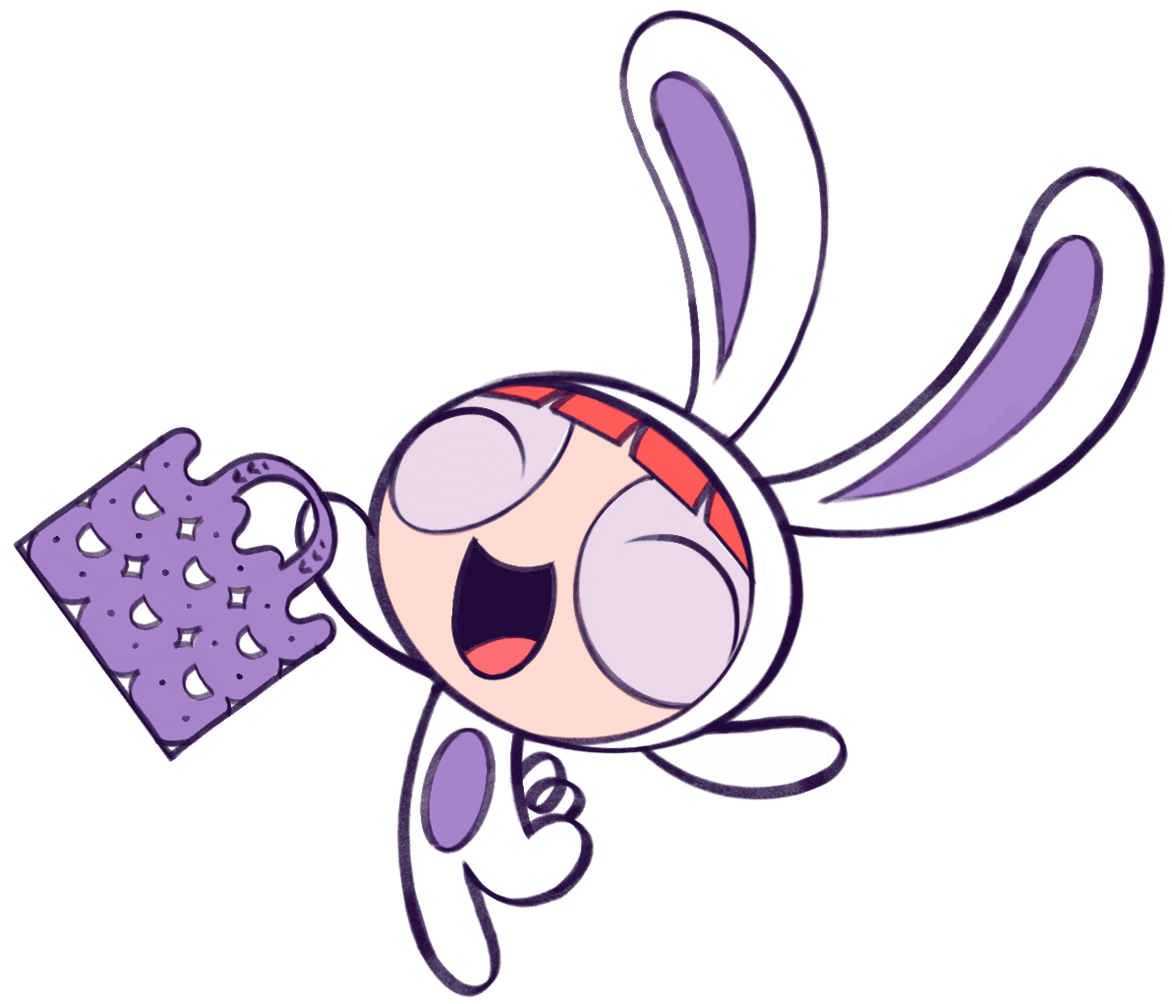

PROS
CONS
You know my Starbucks order
You lie about where you are/what you’re doing
You don’t put in effort planning dates
You wouldn’t watch the Barbie movie with me
Everyone thinks I can do better
My mom doesn’t like you

Slide 4



MY LOVE FOR YOU
NOW

Slide 5


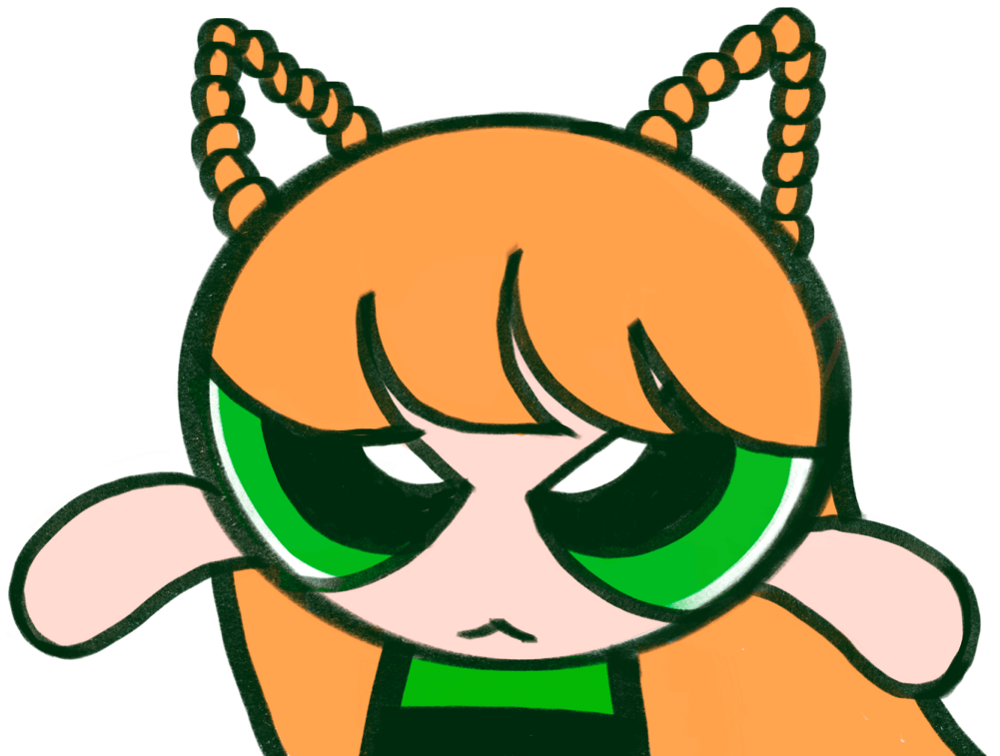

It`S NOT ME, it`S You*
(*ACCORDING TO OUR FRIENDS)
You
80%
ME
20%

Slide 6


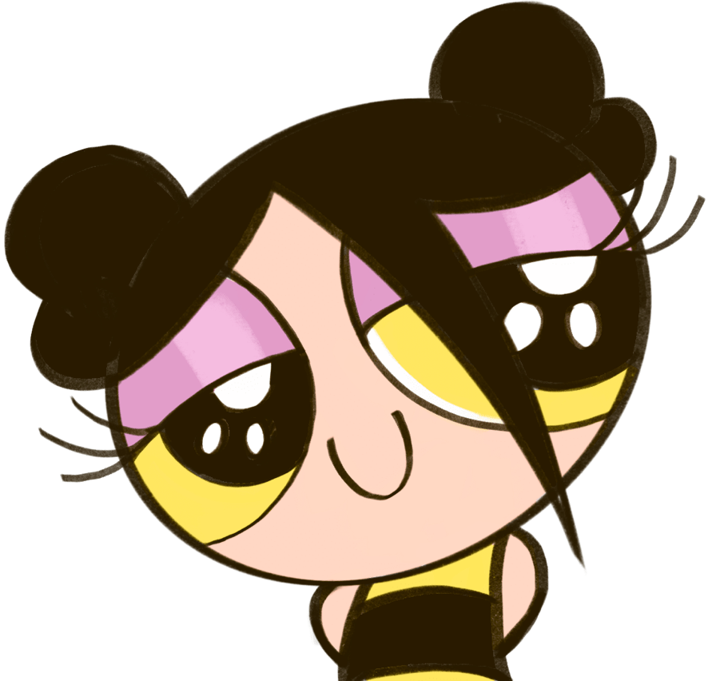

WHAT I`D RATHER DO
THAN DATE YOU
Study
Learn German
Go through puberty again
Read through Apple’s T&Cs

Slide 7
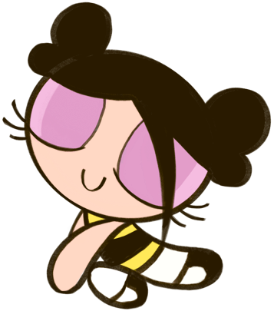

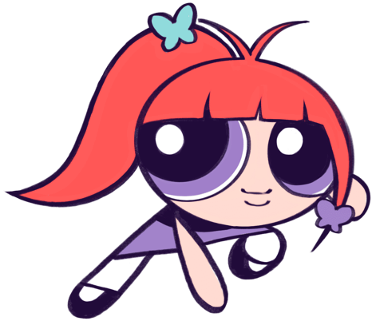
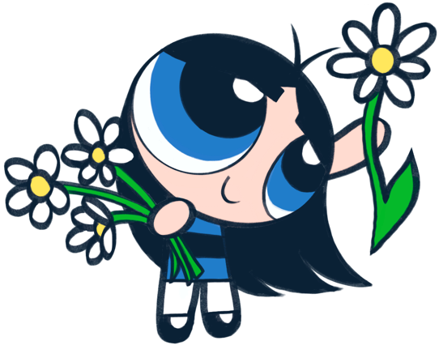
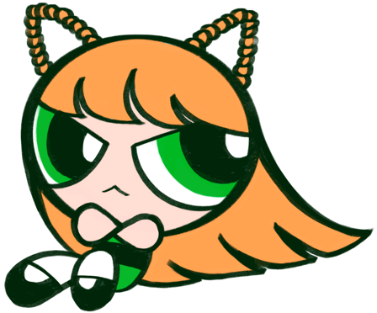


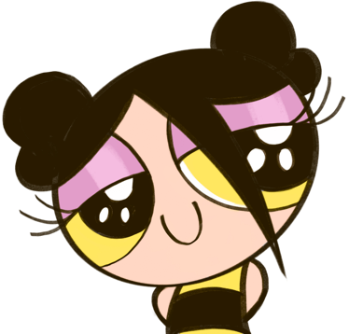


ILLUSTRATIONS

